Slide 1

Open Source FPGA Tooling: The Next Step in our Journey
faith@quicklogic.com
@QuickLogic_Corp
www.quicklogic.com
Brian Faith
CEO
March, 2021

Slide 2
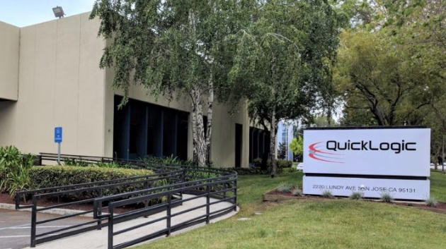
QuickLogic at a Glance
Snapshot
What We Do
QuickLogic is a platform company that enables our customers to quickly and easily create intelligent ultra-low power endpoints to build a smarter, more connected world
We develop ultra-low power, multi-core semiconductor platforms and hardware- and software-based IP for AI, voice and sensor processing applications
End-to-End Solutions
Target Markets
Founded: 1989
Headquarters: San Jose, CA
Hearables and wearables
Consumer and industrial IoT
Smartphones and tablets
Consumer electronics
AI-enabled devices
Aerospace and defense devices
AI Software Platform
SoC
eFPGA IP

Slide 3
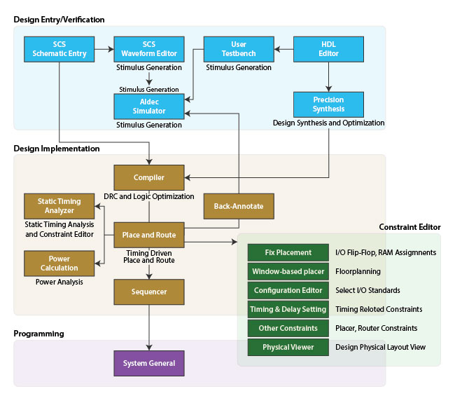
Our Proprietary FPGA Tools 25 Years Ago…
Multiple Synthesis Tools
Multiple Simulators
Multiple FPGA Vendors

Slide 4

Our Walled Garden

Slide 5
Why Do FPGA Vendors Resist?
Because we know:
Humans like routine
Change is painful
Change is risk
And, for those of us who have had robust software…
…Why change?

Slide 6
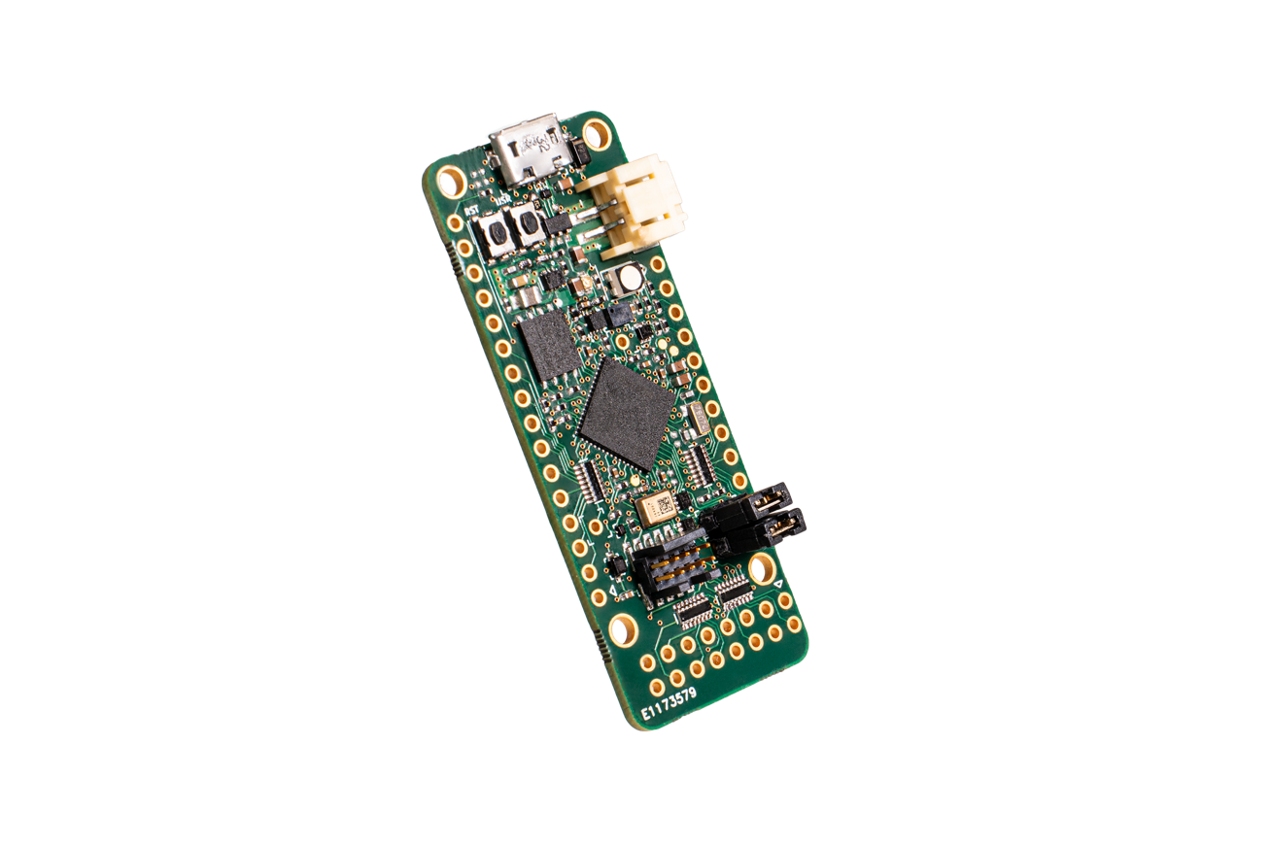

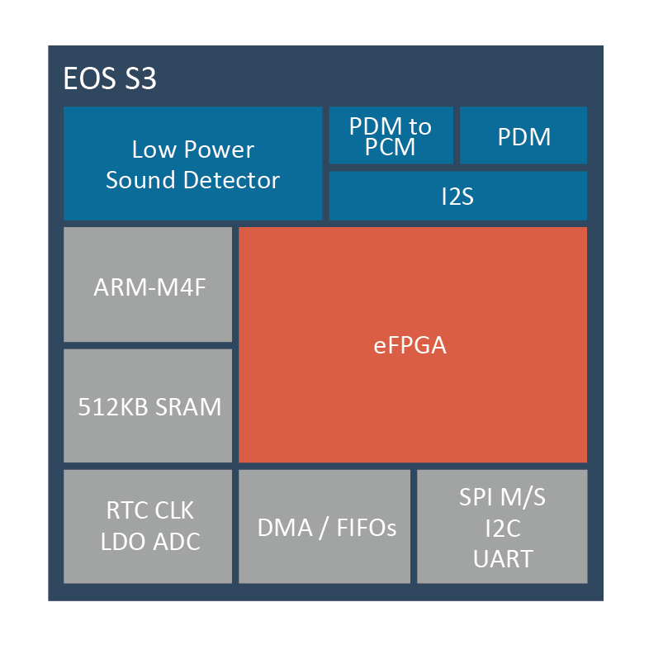




Our Community’s Open Source Tools 1 Year Ago

Slide 7
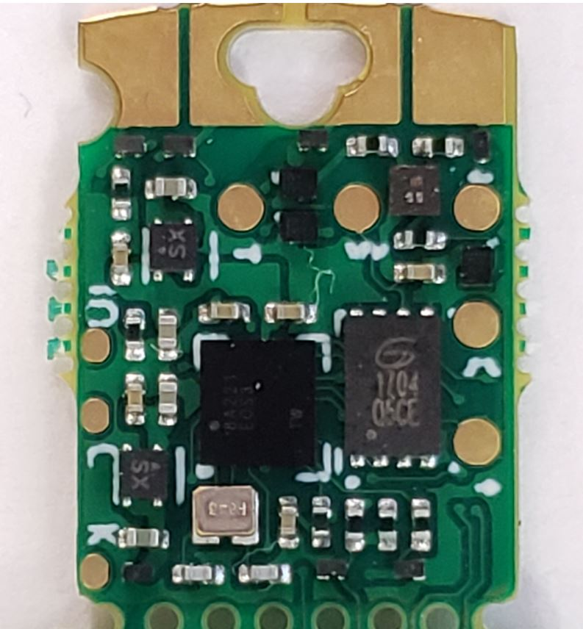


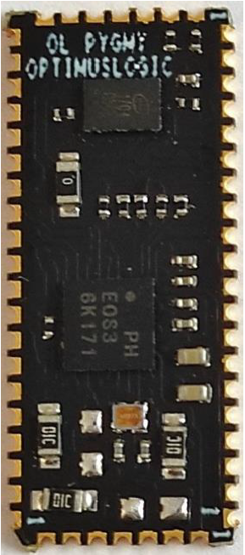
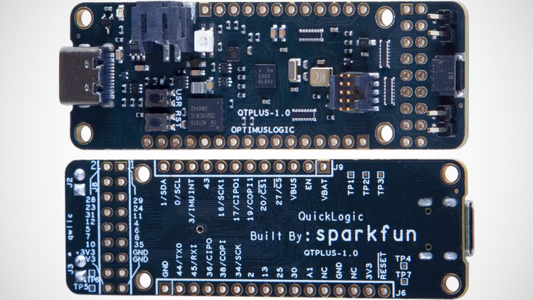



Our Community’s Open Source Tools Now

Slide 8
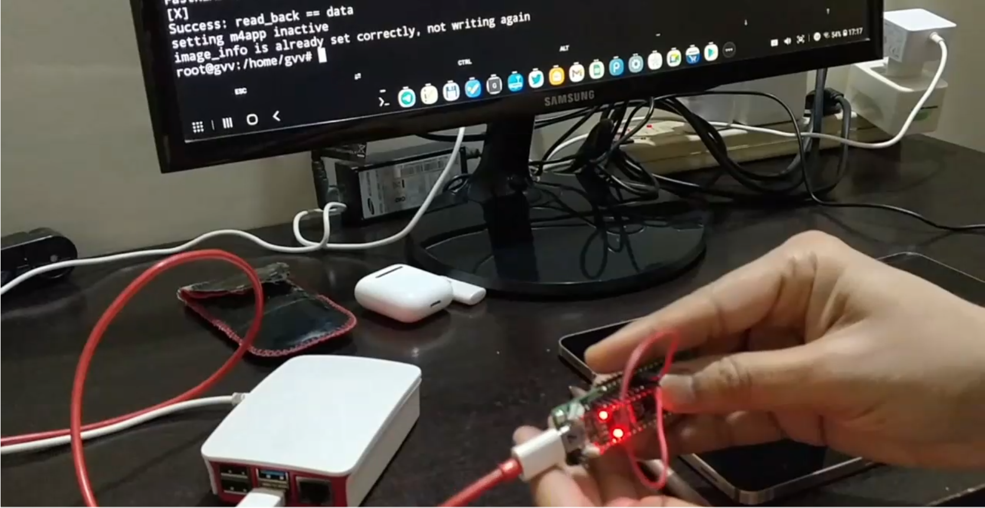
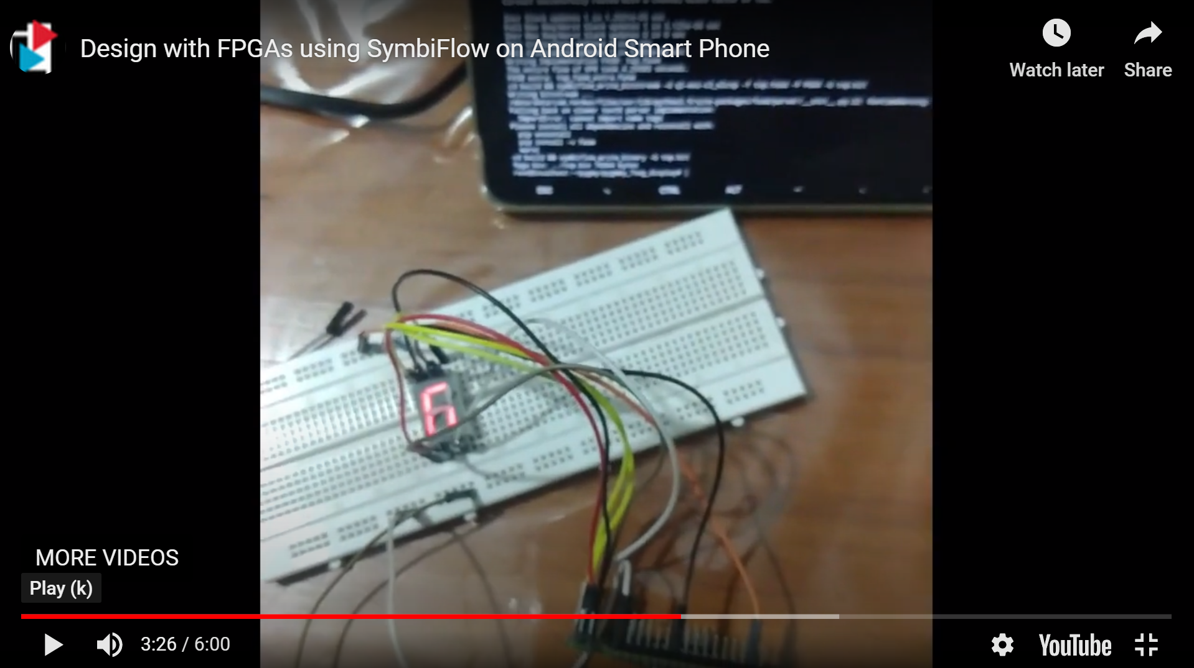
A Glimpse Into the Future – Designing with your Smartphone
https://www.youtube.com/watch?v=bRrJqL3NGlg

Slide 9

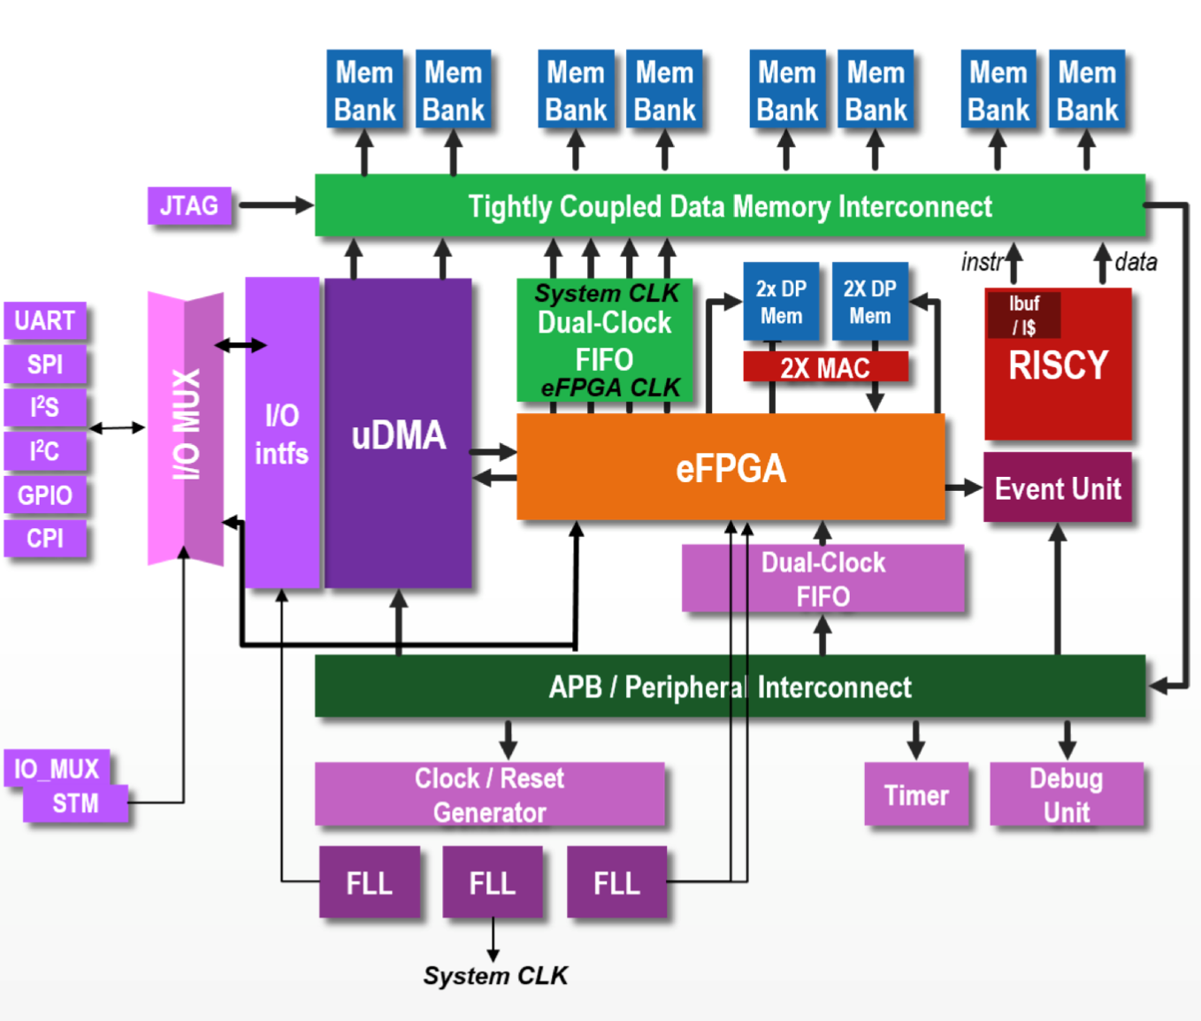

RISC-V MCU + eFPGA SoC
Project announced at Open Source Developer Forum Sept 2020
Real Time Operating System (e.g. Zephyr) capable ~600+MHz CV32 MCU host CPU
Full Renode Support
Embedded FPGA fabric with hardware accelerators from QuickLogic
Multiple low power peripheral interfaces (SPI, GPIO, I2C, HyperRAM, CAMIF, etc) for interfacing with sensors, displays, and connectivity modules
Built in 22FDX with GF
CV32
Image source: QuickLogic

Slide 10
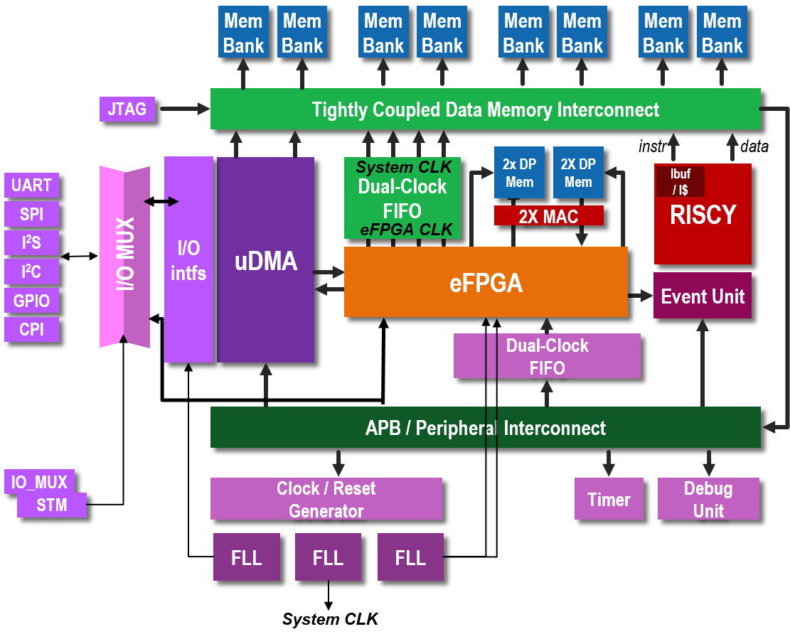
Case Study
Example SoC + eFPGA architecture
CPU and eFPGA tightly coupled with MACs and RAMs
Implementing Visual Wake Words dataset and training (https://blog.tensorflow.org/2019/10/visual-wake-words-with-tensorflow-lite_30.html)
CV32
Notes:
So for this application, we look at a 32-bit RISC-V core, MCU class, hence very low power, and tightly coupled with eFPGA logic, couple of MAC blocks and some RAM blocks, and ran the trained dataset for visual wake words from tensorflow lite.

Slide 11
Changing Our Mindset
For FPGA Companies?
How do we overcome NIH?
How do we help people understand there is more upside than downside?
For FPGA Users?
How do we show the gain from switching is worth the pain?
How do we make pain low?

Slide 12
Thank You

